Slide 1
Brucellosis

Slide 2
Brucellosis is an enzootic infection (i.e. endemic in animals) caused by Gram negative coccobacilli.
The four species causing human disease and their animal hosts are:
Brucella melitensis (goats, sheep and camels in Europe, especially the Mediterranean basin)
B. abortus (cattle, mainly in Africa, Asia and South America),
B. suis (pigs in South Asia)
B. canis (dogs).
B. melitensis causes the most severe disease; B. suis is often associated with abscess formation.

Slide 3
Method of transmission
Infected animals may excrete Brucella spp. in their milk for prolonged periods and human infection is acquired by ingesting contaminated dairy products (especially unpasteurised milk) and uncooked meat.
Animal urine, faeces, vaginal discharge and uterine products may transmit infection through abraded skin or via splashes and aerosols to the respiratory tract and conjunctiva

Slide 4
Clinical features
Brucella spp. are intracellular organisms that survive for long periods within the reticuloendothelial system.
This favours chronicity and relapse, even after antimicrobial therapy.
Acute illness is characterized by a high swinging temperature, rigors, lethargy, headache, arthralgia, myalgia and scrotal pain.
Occasionally, there is delirium, abdominal pain and constipation. Physical signs are non-specific, e.g., enlarged lymph nodes.
Splenomegaly may cause thrombocytopenia.
Localized infection occurs in approximately 30% of patients, particularly if treatment is delayed.

Slide 6
Diagnosis
Definitive diagnosis depends on culture of the organism.
Blood cultures are positive in 75%–80% of B. melitensis and 50% of B. abortus.infections.
Bone marrow culture is not routine but may increase the diagnostic yield if antibiotics have been used prior to culture.
CSF culture in neurobrucellosis is positive in about 30% of cases.
The laboratory should be informed of suspected brucellosis, to allow appropriate laboratory steps to prevent laboratory worker infection.

Slide 7
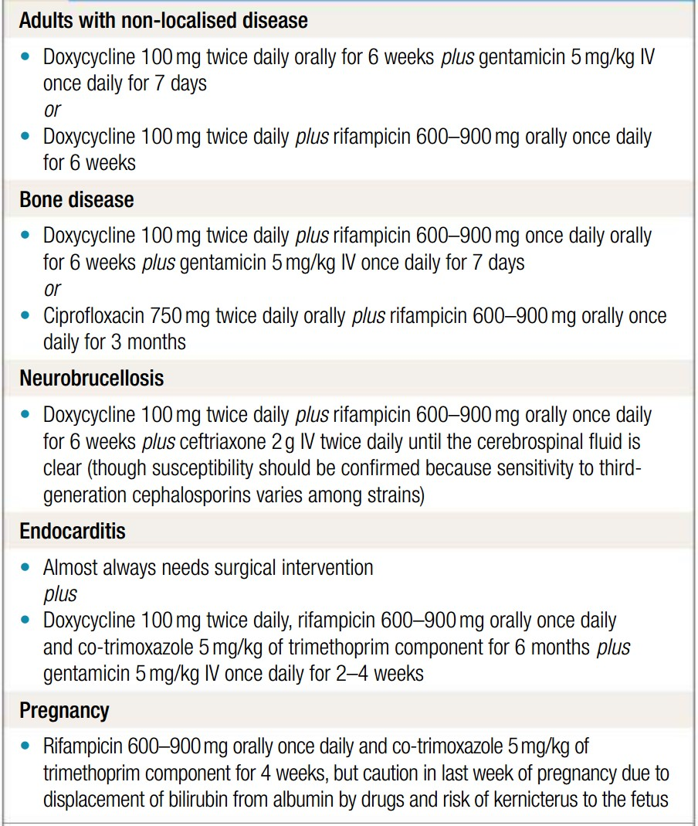
Management
Aminoglycosides show synergistic activity with tetracyclines

